Slide 1
MULTI-CUT REBAR(11)
Advisor : Prof. K.C.Chang
Presenters : You-Ran Nai
Notes:
試試看暫停一下

Slide 2
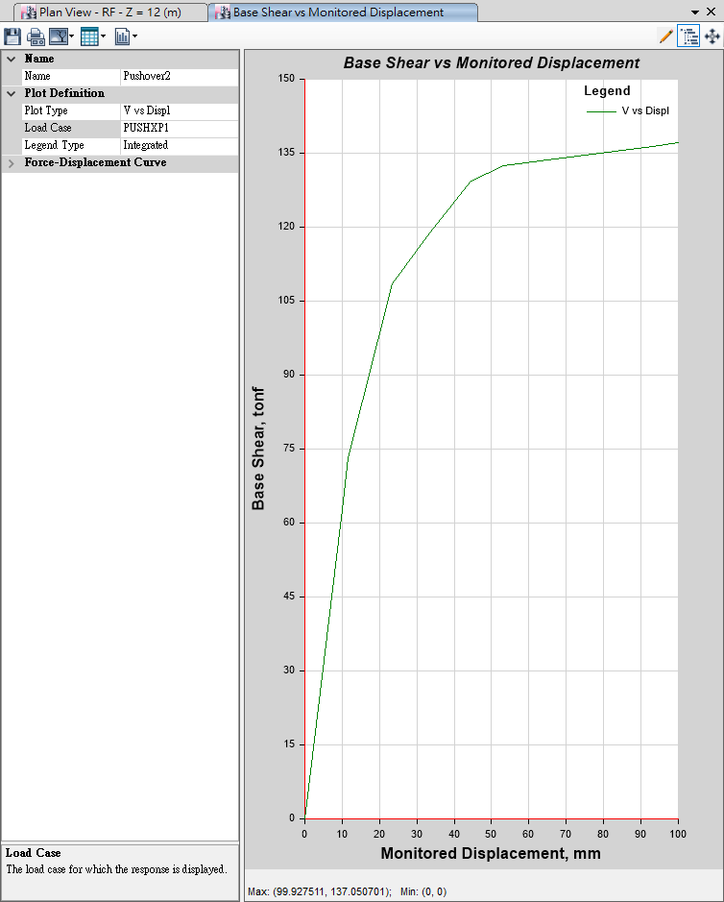
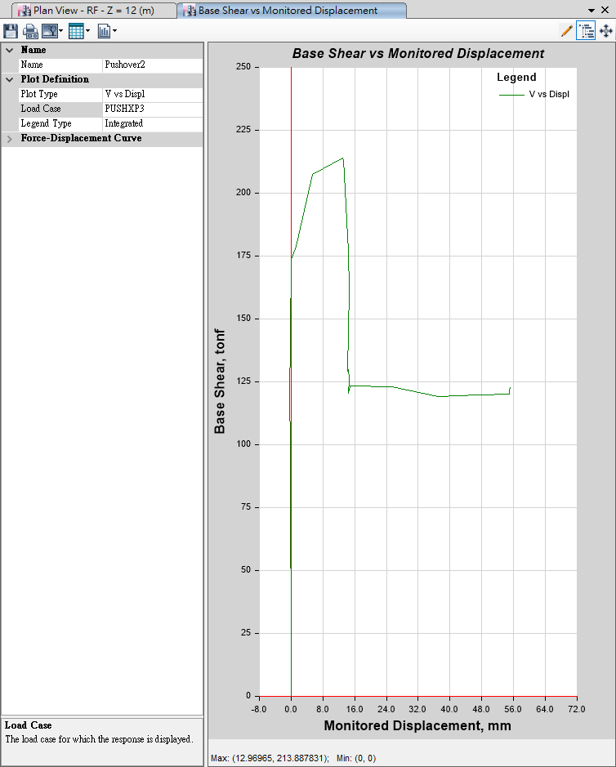
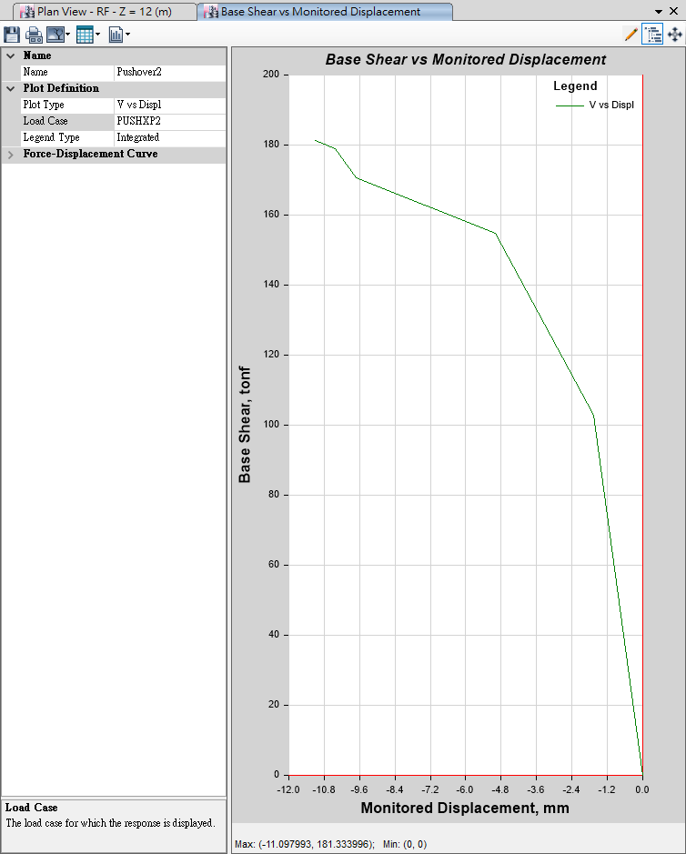
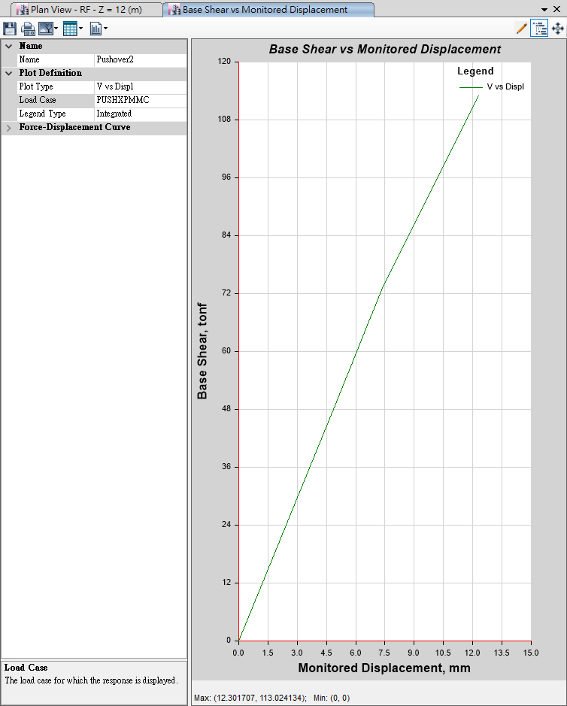
Pushover
Mode 1
Mode 3
100mm
10mm
User Defined
Mode 2
MMC
10mm
10mm

Slide 3
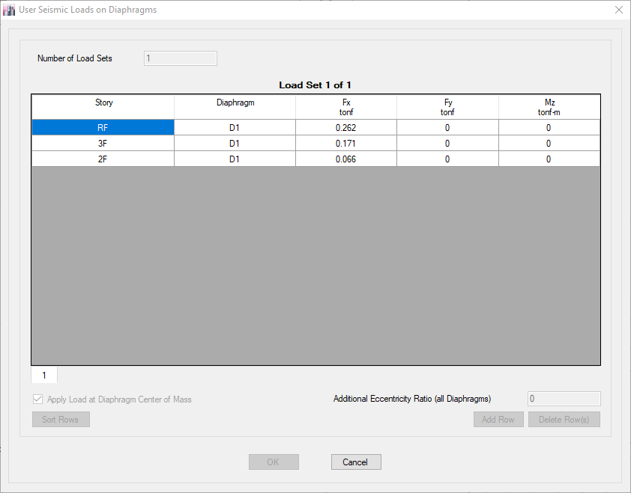
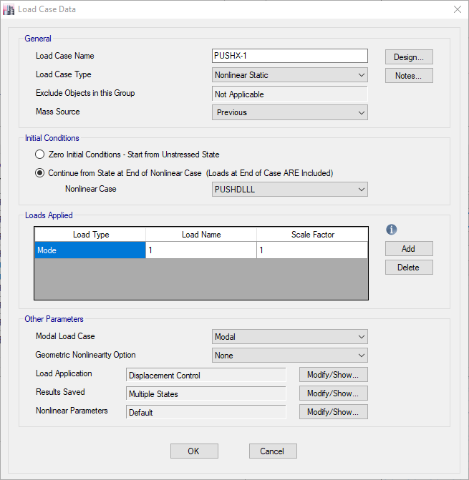

Auto Generate Mode
User Defined Mode

Slide 4
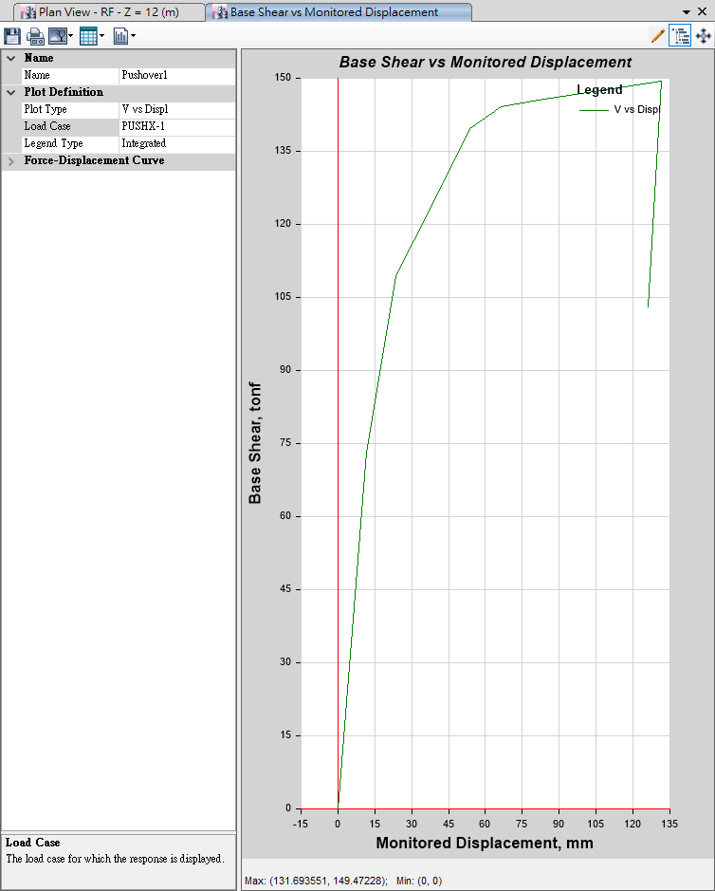
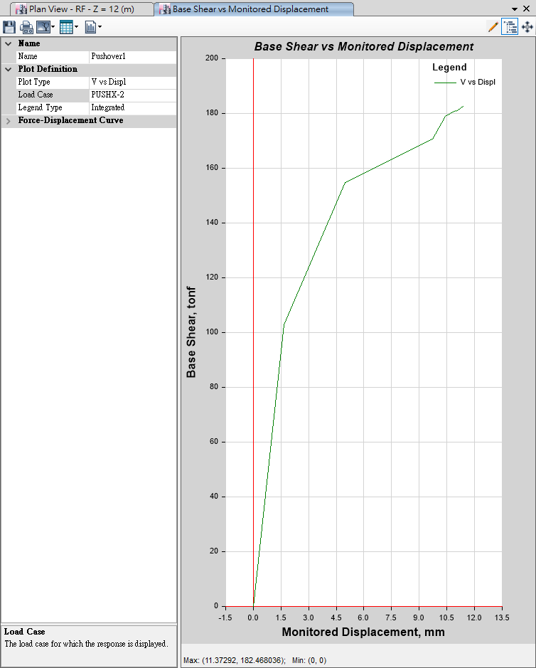
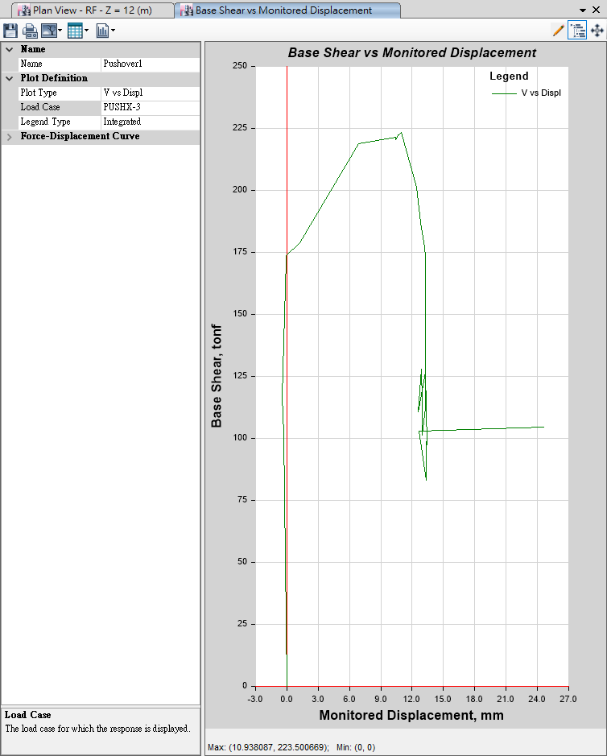
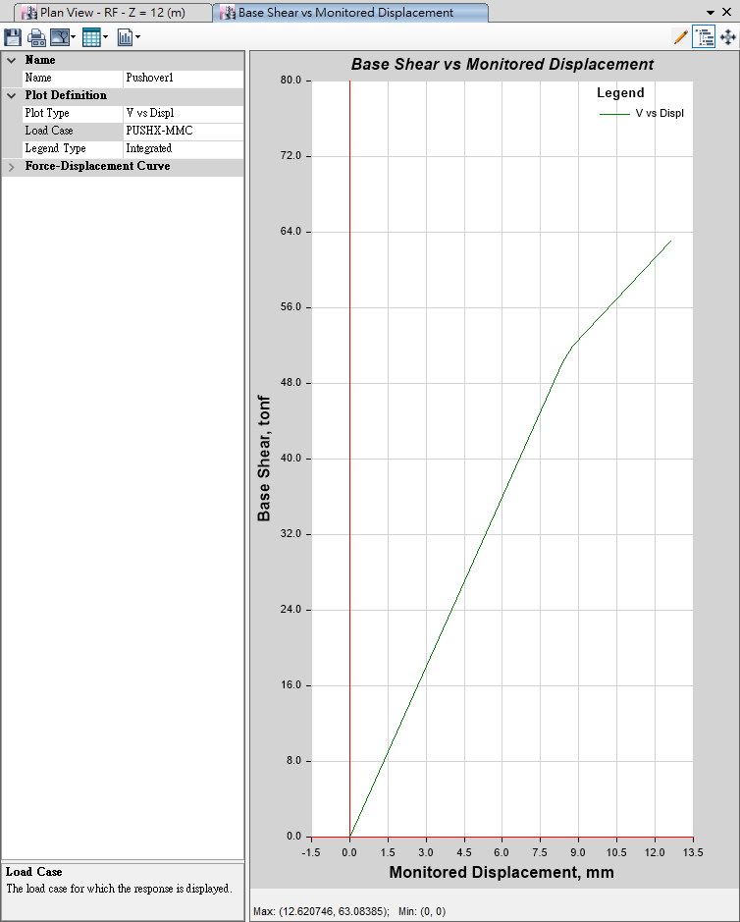
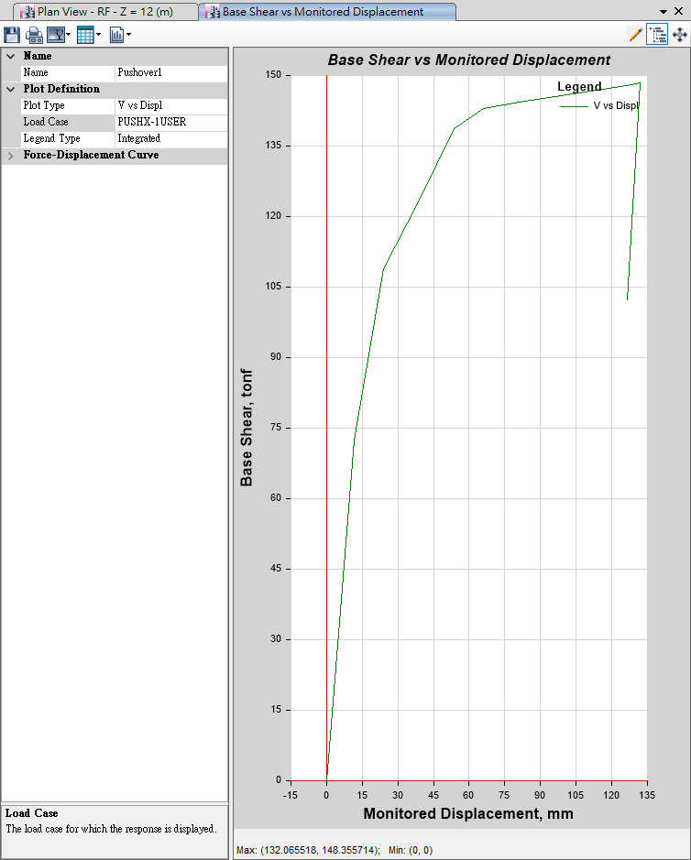
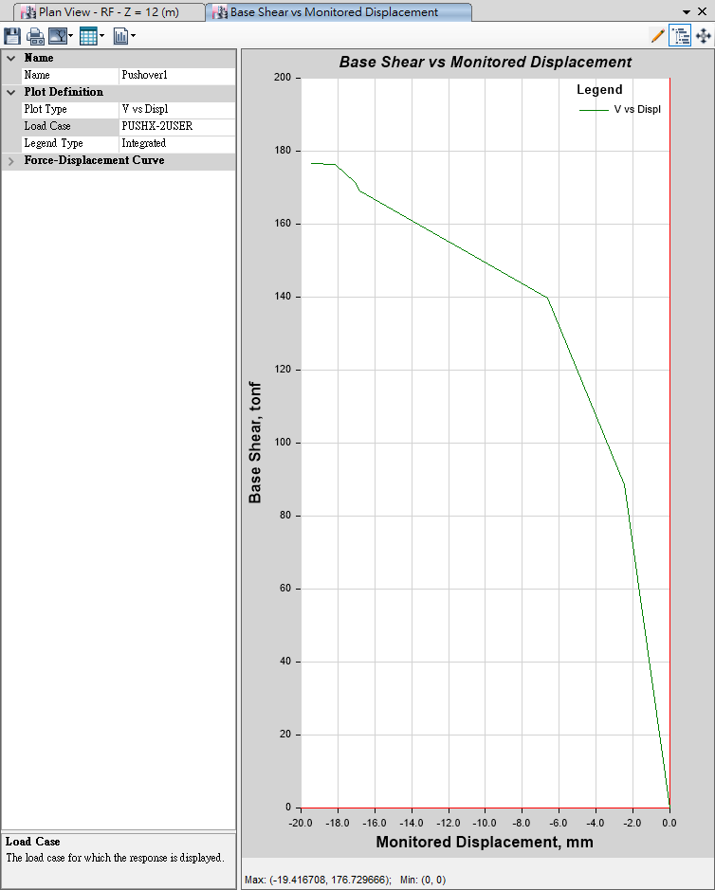
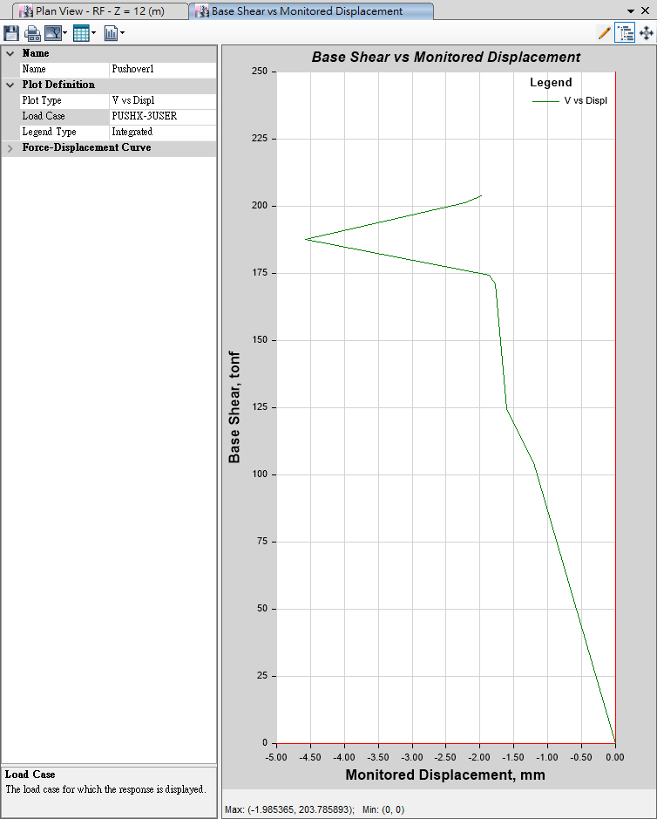

Auto
Generate
Mode
Mode 1
135mm
Mode 2
13mm
Mode 3
27mm
-MMC-
13mm
User Defined
User
Defined
Mode
Mode 1
135mm
Mode 2
20mm
Mode 3
5mm
-MMC-
150mm

Slide 5
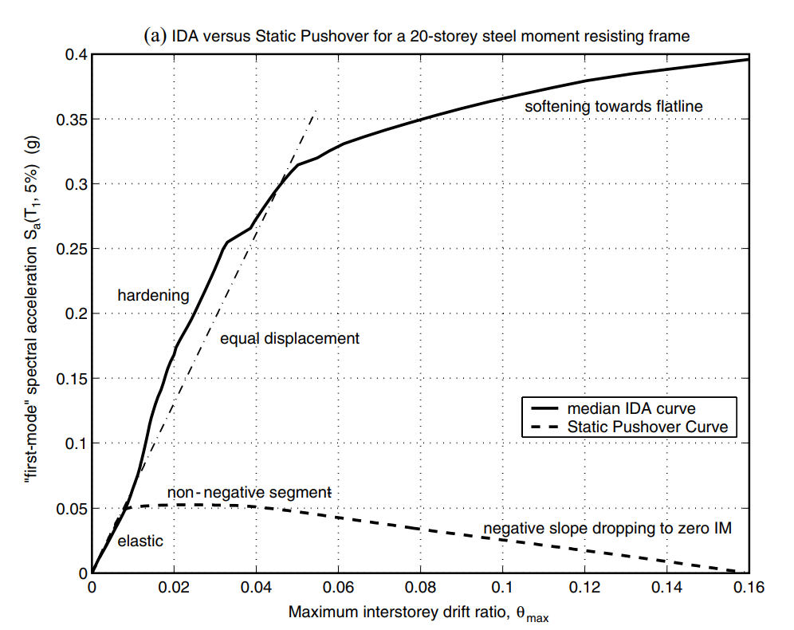
NON-LINEAR SPO
ELASTIC
➔
MATCH
NON-NEGATIVE
➔
EQUAL DISPLACEMENT
NEGATIVE
➔
SOFTENING

Slide 6
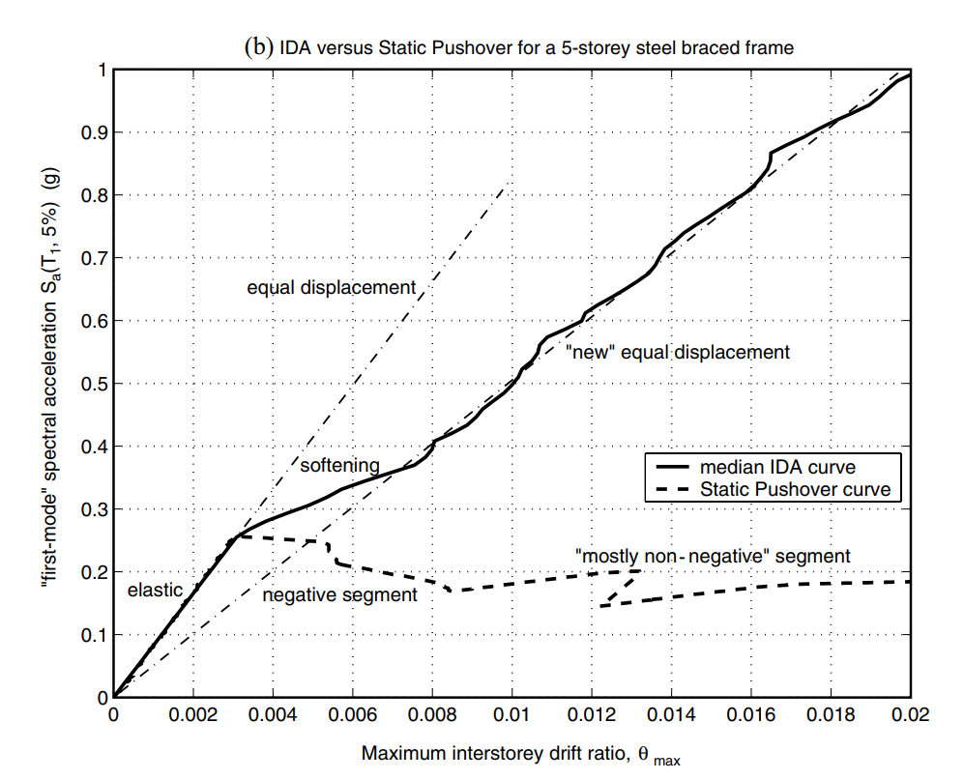
NON-LINEAR SPO
NEGATIVE => NON-NEGATIVE
NEW
EQUAL DISPLACEMENT
➔

Slide 7
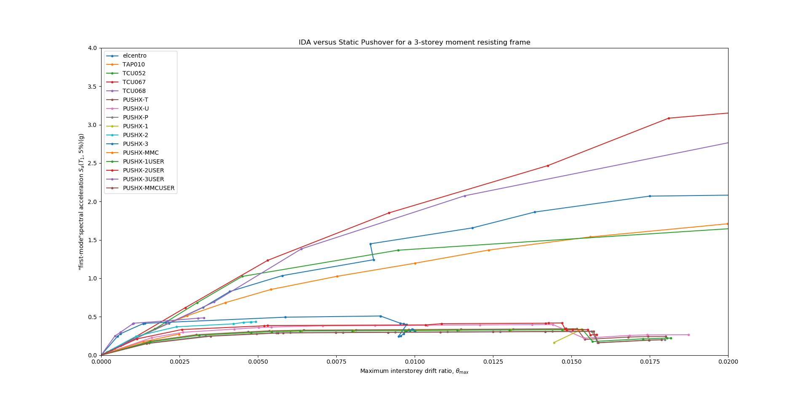

Slide 8
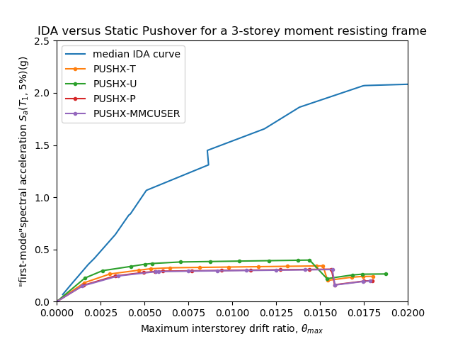
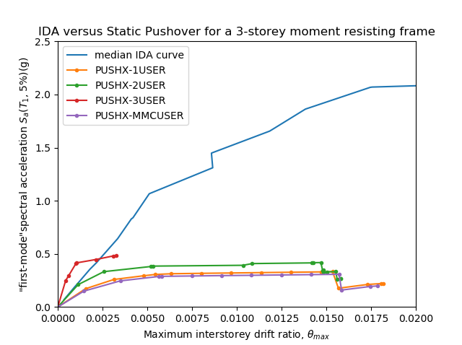
IDA vs Pushover

Slide 9
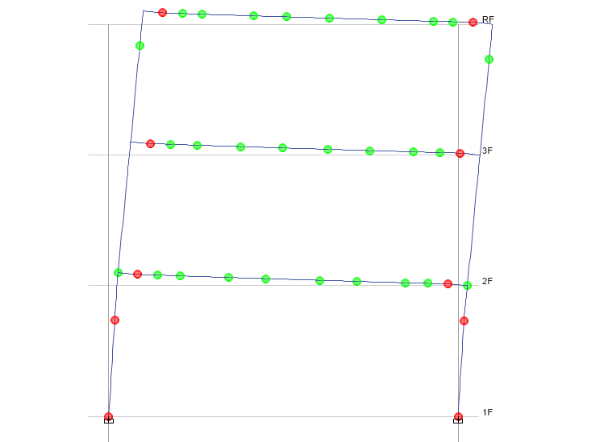
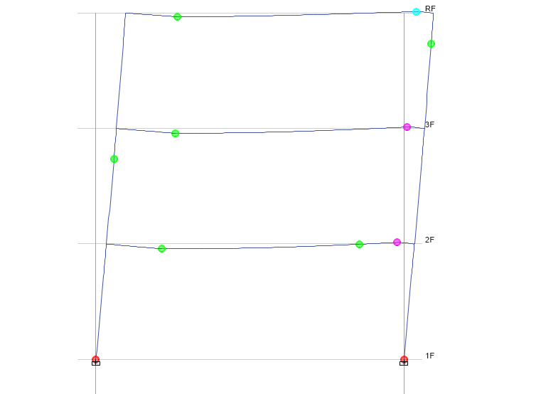
Beam Design
Time History
Pushover
No Middle Hinge

Slide 10
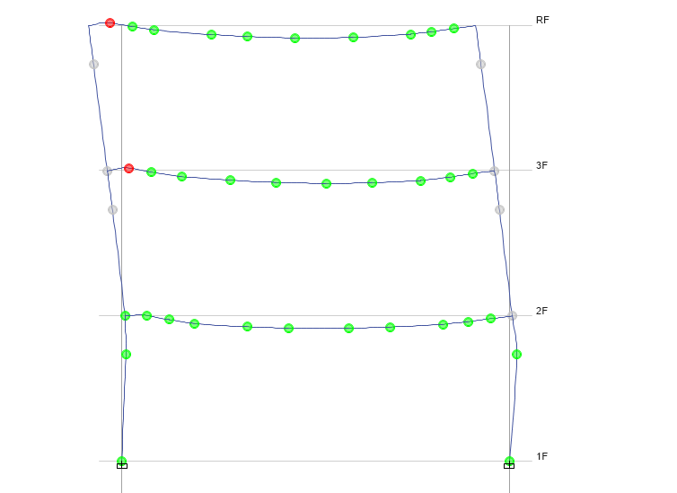
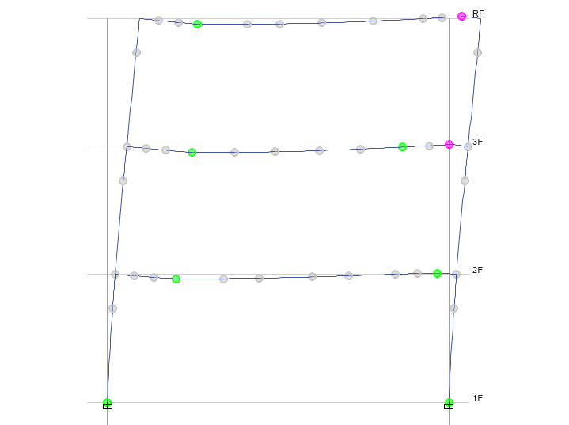
Strong Column Weak Beam
Time History
Pushover
No Middle Hinge

Slide 11
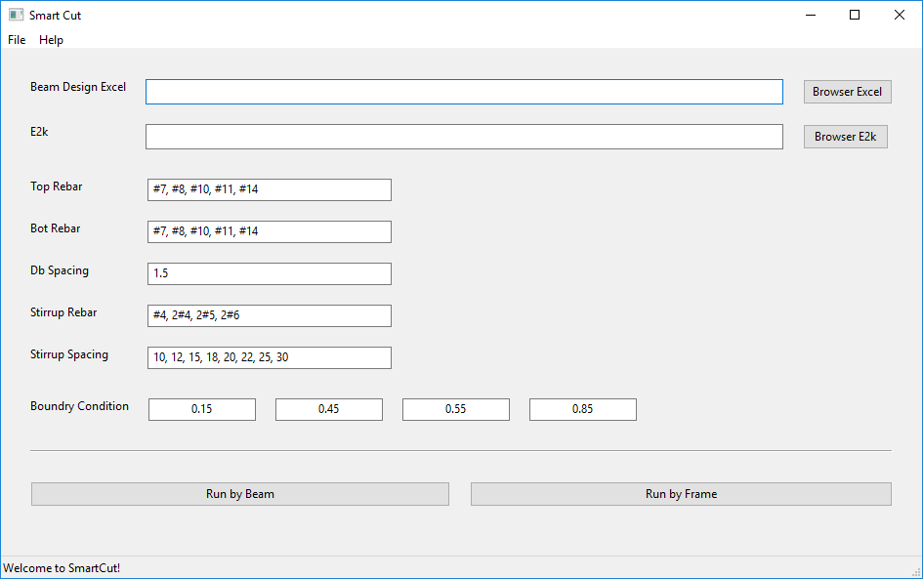
LinearCut GUI

Slide 12
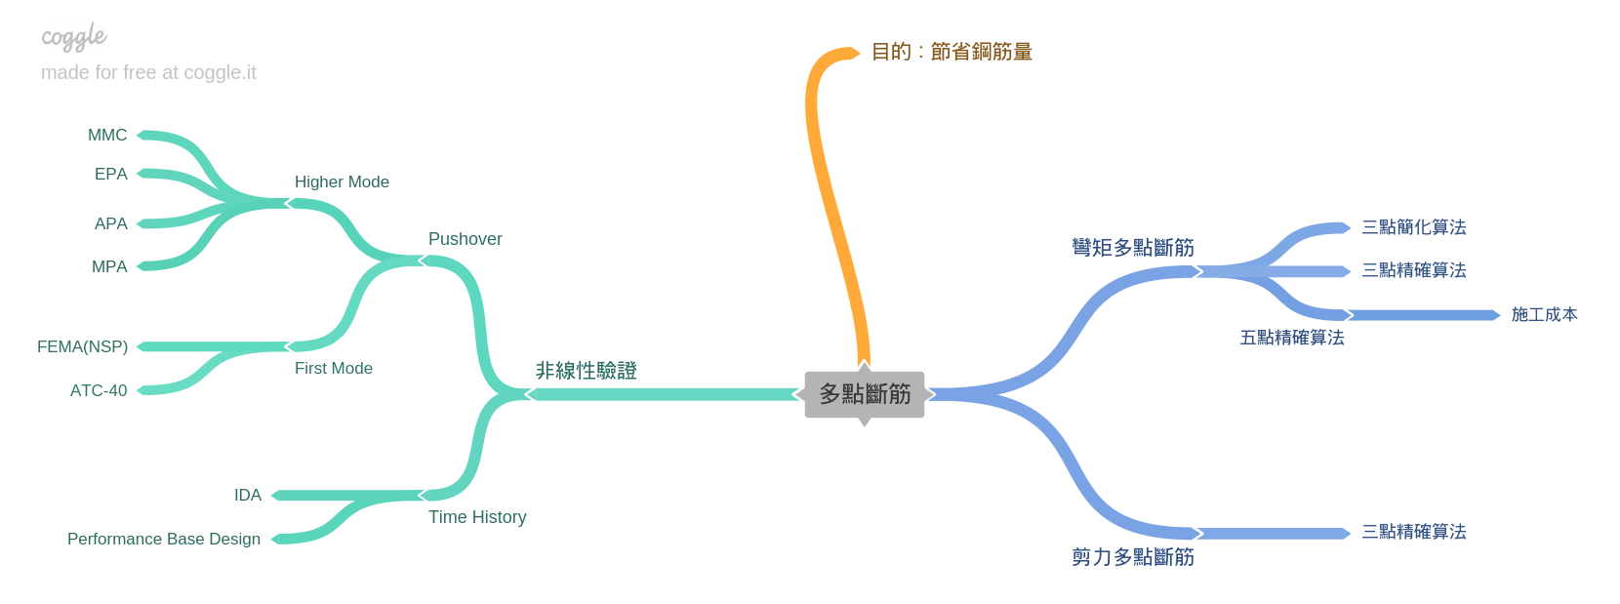
Roadmap
GUI
Nonlinear Hinge

